Slide 1
Hack The Markets - EDA
María José Blanco Vicente

Slide 2
Hack The Markets - EDA
The dataset contains 9 variables:
Date rsi
Open ema_fast
High ema_slow
Low volatility
Close
It has 1035 rows

Slide 3
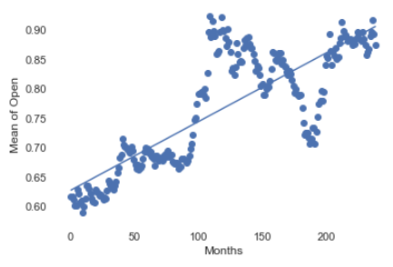
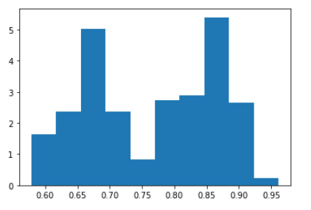
Hack The Markets - EDA
Open, High, Low and Close variables have similar behavior over time
They also have similar distribution

Slide 4
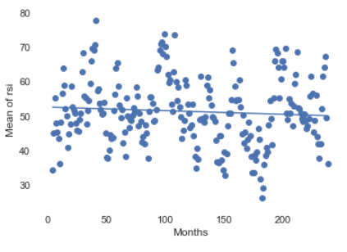
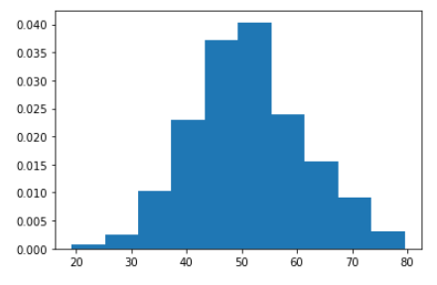
Hack The Markets - EDA
rsi variable has a stable behavior over time maintaining the mean and variance
It has a Normal distribution

Slide 5
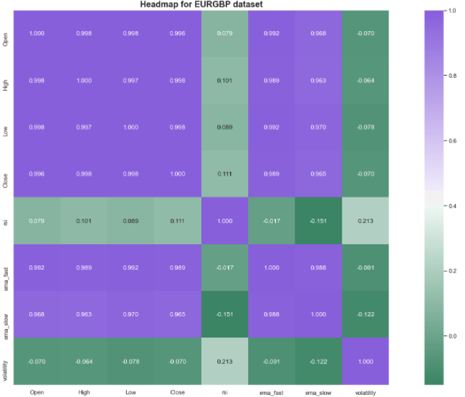
Hack The Markets - EDA
Open,High,Low and Close are highly correlated
ema_fast and ema_slow are also higly correlated
rsi and volatility are not correlated with any variable

